Slide 1

Low-Memory NN Training
Sparsity
Presenter: Kim Tae Hyeon

Slide 2
Contents
Introduction
Recent Work
Method
Discussion

Slide 3
Introduction : Issue
How much memory is actually needed to train a neural network?
Model Memory : consists of the model parameters
Optimizer Memory : consists of the gradients and momentum vectors
Activation Memory : consists of the intermediate network activations

Slide 4
Introduction : Issue
Figure 1: Pie charts of training memory consumption for WideResNet on CIFAR-10 [1]

Slide 5
Introduction : Issue
Model Memory
It is simply the memory used to store the model parameters,
i.e. the weights and biases of each layer in the network.
Only major memory type that is common across both inference and training for the model architecture.

Slide 6
Introduction : Issue
Optimizer Memory
It refers to the memory used to store the gradients and any momentum buffers during training.
During backpropagation, compute the gradient with respect to all trainable model parameters.

Slide 7
Introduction : Issue
Activation Memory
During training, the outputs, or activations, of each layer in the network are stored for reuses in the backward pass of backpropagation
(They also count the network inputs as part of the forward activation memory if they need to be stored for reuse in the backward pass.)

Slide 8
Introduction : Technique
How to control these memories?
Of course, there are trade-offs between accuracies and memory reduction
Four memory reduction techniques
Sparsity
Low precision
Microbatching
Gradient checkpointing

Slide 9
Introduction : Technique
1. Sparsity
What is the definition of sparse?
➔ A sparse tensor is a tensor in which most of the entries are zero.
The zero entries do not need to be explicitly stored, so it can reduce the memory usage.
Techniques
Traditional : apply sparsity to compress pre-trained model with little or no loss of accuracy.
Recent : maintain sparsity throughout the entire training process.

Slide 10
Introduction : Technique
2. Low Precision
Precision
Generally, model is trained in single precision (FP32) (IEEE 32-bit] arithmetic.
It enables the model both to reduce all components of memory and to decrease the total amount of required computations.
Techniques
Recent : Half precision (FP16) [IEEE 16-bit] arithmetic is generally sufficient for training

Slide 11
Introduction : Technique
3. Microbatching
Issue
The memory required for computing and storing the network activation can far outstrip the memory required to store the model itself.
Two possible solutions are to downsample the input data to a smaller size, or to make the model “narrower” {(ex) reducing the number of output channels of each convolution)
What is microbatching?
The minibatch is split into smaller groups called microbatching
The gradients are accumulated in a separate buffer until the desired number of examples is processed, and only then are the parameters and momentum buffers updated.

Slide 12
Introduction : Technique
4. Gradient checkpointing
What is Gradient checkpointing?
It is an algorithm to save memory on the network activations by only storing the activations of a subset of layers, rather than those of each layer as usual.
The activations that are discarded are recomputed when necessary during backpropagation.
Checkpointing is particularly convenient because the outcome of the forward and backward passes is mathematically and numerically equivalent whether or not checkpointing is used, and so there is no memory-accuracy tradeoff.

Slide 13
Contents
Introduction
Recent Work
Method
Discussion

Slide 14
Recent Work : Sparsity
Paper
2019 ICML
Parameter Efficient Training of Deep Convolutional Neural Networks
by Dynamic Sparse Reparameterization

Slide 15
Recent Work : Sparsity
Issue
Training remains memory-inefficient despite the compact size of the resultant network produced by compression.
Training-time parameter efficiency.
Hypothesis
Overparameterization during training might not be a strict necessity and alternative training or reparameterization methods might exist to discover and train compact networks directly.

Slide 16
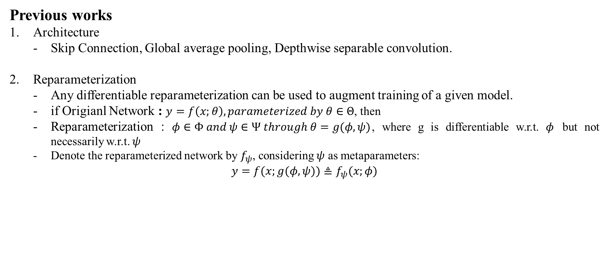
Recent Work : Sparsity
Previous works
Architecture
Skip Connection, Global average pooling, Depthwise separable convolution.
Reparameterization
Any differentiable reparameterization can be used to augment training of a given model.
if Origianl Network : $y=f\left(x;θ\right), parameterized by θ∈Θ$, then
Reparameterization : $φ∈Φ and ψ∈Ψ through θ=g(φ,ψ)$, where g is differentiable w.r.t. $φ$ but not necessarily w.r.t. $ψ$
Denote the reparameterized network by $f_{ψ}$, considering $ψ$ as metaparameters:
$$y=f(x;g(φ,ψ))≜f_{ψ}(x;φ)$$

Slide 17
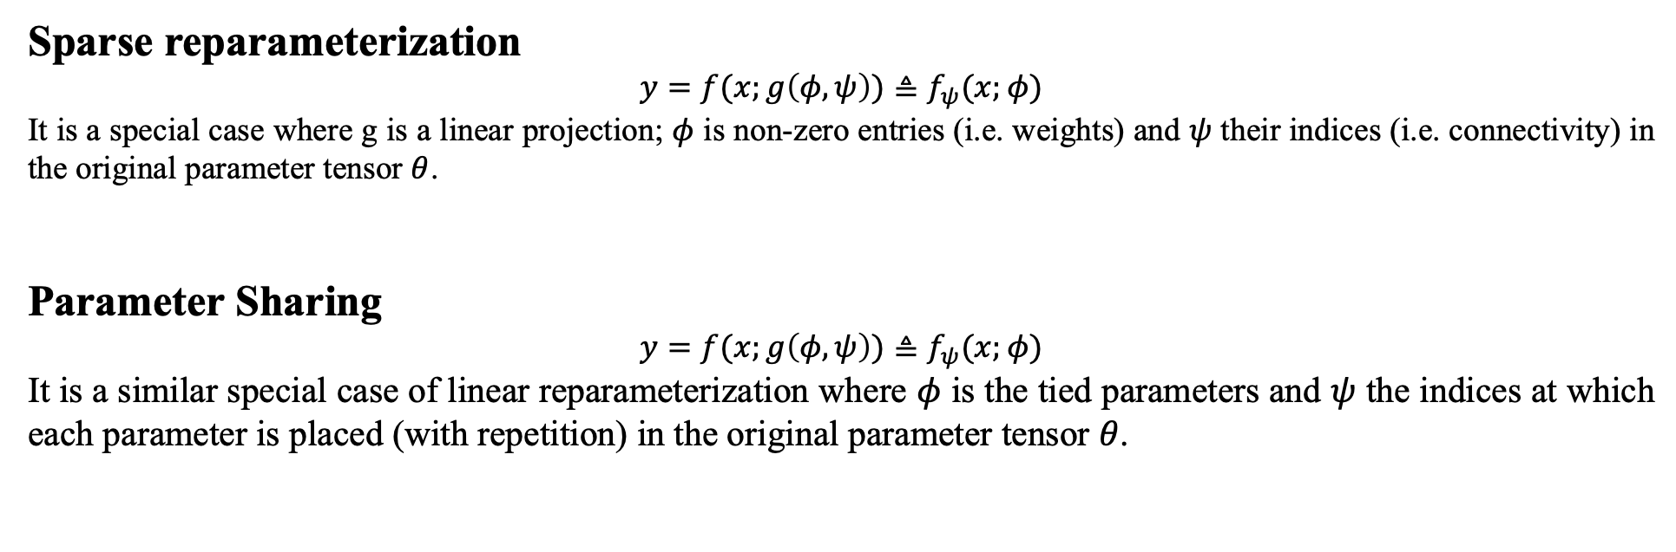
Recent Work : Sparsity
Sparse reparameterization
$$y=f(x;g\left(φ,ψ\right))≜f_{ψ}(x;φ)$$
It is a special case where g is a linear projection; $φ$ is non-zero entries (i.e. weights) and $ψ$ their indices (i.e. connectivity) in the original parameter tensor $θ$.
Parameter Sharing
$$y=f(x;g\left(φ,ψ\right))≜f_{ψ}(x;φ)$$
It is a similar special case of linear reparameterization where $φ$ is the tied parameters and $ψ$ the indices at which each parameter is placed (with repetition) in the original parameter tensor $θ$.

Slide 18
Recent Work : Sparsity
Dense reparameterization
low-rank decomposition
Fastfood transform
ACDC transform
Hashed-Net
Low displacement rank
Block-circulant matrix parameterization
Sparse reparameterization
Iteratively pruning and retraining
Pretrained & pruning and fine-tuning
Lottery Ticket Hypothesis (2019 ICLR Oral)

Slide 19
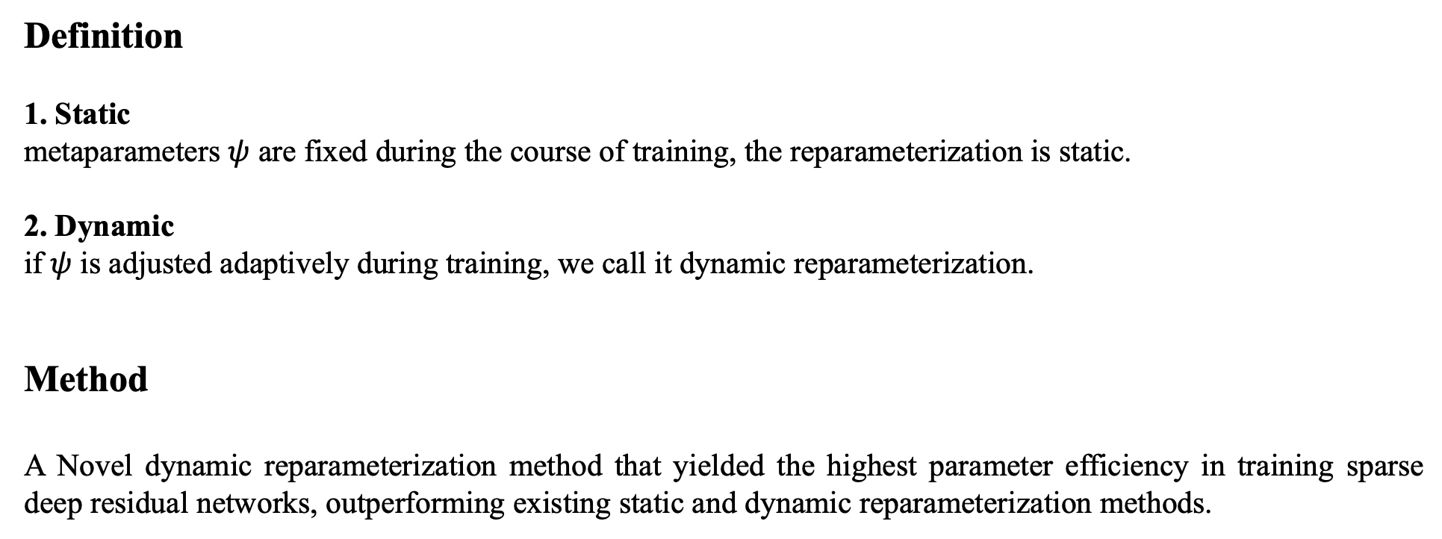
Recent Work : Sparsity
Definition
1. Static
metaparameters $ψ$ are fixed during the course of training, the reparameterization is static.
2. Dynamic
if 𝜓 is adjusted adaptively during training, we call it dynamic reparameterization.
Method
A Novel dynamic reparameterization method that yielded the highest parameter efficiency in training sparse deep residual networks, outperforming existing static and dynamic reparameterization methods.

Slide 20
Contents
Introduction
Recent Work
Method
Discussion

Slide 21
Method
Algorithm
Case.
If a layer has been heavily pruned, this indicates that, for a large portion of its parameters, the training loss gradients are not large or consistent enough to counter act the pull towards zero exerted by weight-decay regularization. This layer is therefore to receive a smaller share of new free parameters during the growth phase.

Slide 22
Method
Results

Slide 23
Contents
Introduction
Recent Work
Method
Discussion

Slide 24
Discussion
1. Why this mechanism yield high performance?
They found that neither the post hoc sparseness pattern, nor the combination of connectivity and initialization, managed to explain the high performance of sparse networks produced by their dynamic sparse training method. Thus, the value of dynamic parameter reallocation goes beyond discovering trainable sparse network structure: the evolutionary process of structural exploration itself seems helpful for SGD to converge to better weights.
Analysis (previous)
One hypothesis is that the discontinuous jumps in parameter space when parameters are reallocated across layers helped training escape sharp minima that generalize badly.

Slide 25
Discussion
2. Structural degrees of freedom
Structural degrees of freedom are qualitatively different from the degrees of freedom introduced by overparameterization. The latter directly expands the dimensionality of the parameter space in which SGD directly optimizes, whereas structural degrees of freedom are realized and explored using non-differentiable heuristics that only interact indirectly with the dynamics of gradient-based optimization, e.g. regularization pulling weights towards zero causing connections to be pruned. Their results suggest that, for residual CNNs under a given descriptive complexity (i.e. memory storage) constraint, it is better (in the sense of producing models that generalize better) to allocate some memory to describe and explore structural degrees of freedom, than to allocate all memory to conventional weights.

Slide 26
Discussion
Contribution
it is possible to train deep sparse CNNs directly to reach generalization performances comparable to those achieved by iterative pruning and fine-tuning of pre-trained large dense models.
dynamic exploration of structural degrees of freedom during training is crucial to effective learning.

Slide 27
Thank you

Slide 28
Reference
[1] Sohoni, N. S., Aberger, C. R., Leszczynski, M., Zhang, J., & Ré, C. (2019). Low-Memory Neural Network Training: A Technical Report. arXiv preprint arXiv:1904.10631.

